Slide 1

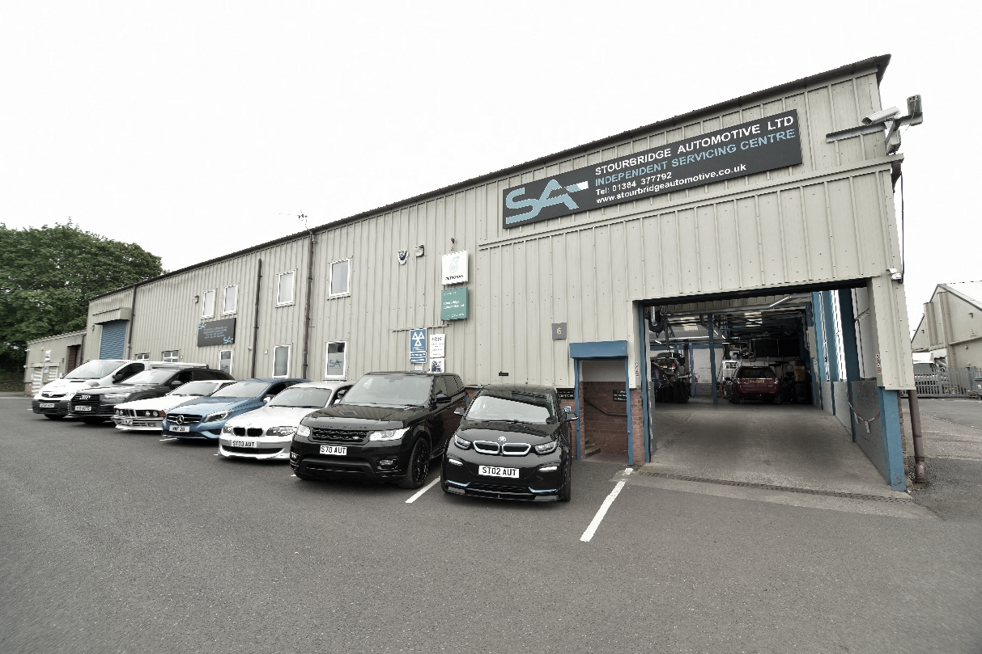






www.stourbridgeautomotive.co.uk
Unit 6, Gainsborough Trading Estate, Rufford Road,
Stourbridge, West Midlands DY9 7ND

Slide 2
Company Overview
Stourbridge Automotive Ltd prides itself on working towards a common goal, using integrity, honesty and respect for both customers and colleagues alike. Together, with a diverse range of knowledge and skills, we strive to make a better future and experience for all.
May 2010 –Stourbridge Automotive established BMW & Mercedes Independent Servicing & Repairs
Sept 2013 – Relocate to current address
Apr 2014 – MOT testing site
Oct 2014 – Audi Servicing & Repairs
May 2015 – Health & Safety written policy
Oct 2015 - AC Schnitzer approved dealer
Mar 2017 - Company restructure –
Middle management
Mar 2019 – Workshop expansion
Nov 2019 – Low Carbon Workspace certification
Nov 2019 - JLR Group Servicing & Repairs
June 2022 – EV servicing & Repairs
June 2023 IGA Garage of the Year Customer Service Finalist
Sept 2023 - IGA Independent Garage Association Independent Garage of the Year – Winner
Feb 2024 – Customer Finance credit terms
Mar 2024 – Social media upscale
Sept 2024 – New GMS system installed
Sept 2024 - IGA Independent Garage Association Training & Development – Winner
2025 – Fifteen years in business and a company restructure

Slide 3
Operational Structure
Neil Fellows
Director
Kay Fellows
Director
Matthew Bird
General Manager
Workshop
Team
Office
Team
Front of House
Team

Slide 4




Trade memberships
The Retail Motor Industry Federation
Independent Garage Association
IGA Garage Safe
1 TEC
Bumper Finance credit
Warrantywise
TRUST My Garage

Slide 5
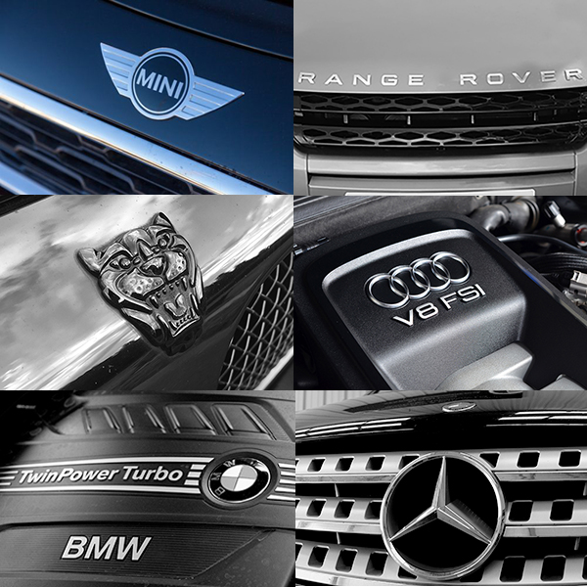
Current Services
Servicing including EV & Hybrid
Mechanical Repairs
Diagnostics appointments
MOT Testing Site
Air Conditioning Services
AC Schnitzer BMW upgrades
- (approved dealer)
BMW - Timing Chain Repairs
Engine & Fuel Treatment
Vehicle Checks

Slide 6
New Business Development
Scale up social media presence through existing and new platforms
Continue to raise SA business profile & SA customer awareness
Sponsorship of local charity & events
Flexible finance credit terms for customers
Reduction of ‘Carbon footprint’ continued
Apprentice programmes with local college continued
4 Wheel Alignment Servicing investment

Slide 7



Training & Recruitment
Having a well-trained and an accomplished team is paramount to the success of any business. Through regular recruitment, we assess where new skills are required, that will benefit the business, support colleagues within each department and advance individual careers.
Further to this and aligned with local colleges, we offer regular training courses for employees to advance and improve their own skills, with a focus on building positive careers.
Employee Course Examples:
IMI
NVQ’s
Apprenticeships
First Aid courses
Mental Health First Aid courses
Non-Vocational Courses
Annual Appraisals

Slide 8
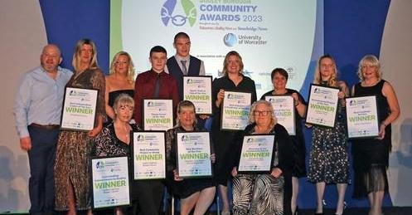
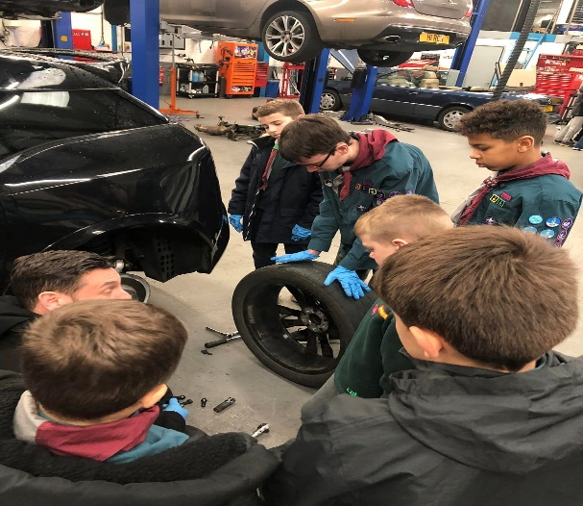
Community commitment
As a local business, we take a role within the local community seriously, through supporting and assisting local organisations and charities where we can. It is always an honour to give something back, by connecting with local people from a diverse range of community groups.
Through offering our support, whether it be financial help or our volunteering work, it is always thoroughly rewarding for Stourbridge Automotive Limited to take part in community activities.
Recent events for SA:
Dudley Community Awards sponsorship - Nov 2024
Local Scouts group completing badge work - Feb 2024

Slide 9
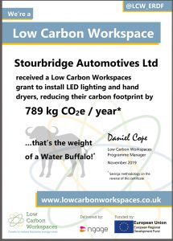
Environmental Commitment
Our business recognises that it has a vital part to play in respect of environmental sustainability. Continually, we work towards reducing our impact through the safe disposal of our products, recycling options and the use of environmentally friendly equipment. We actively commit to lowering our carbon footprint through following Environmental Green Policy processes:
Stourbridge Automotive Ltd is a Low Carbon Workspace
- certified in November 2019
Oil – Waste oil collected and removed safely from the premises by Vehicle Waste Recycling Ltd, with a certification guarantee.
Oil Filters - All filters are collected and removed safely from the premises by Vehicle Waste Recycling Ltd, with a certification guarantee.
Car Batteries & scrap metals - Recycled through local commercial recycling centers.
Lighting & Hand-dryers- All 22 workshop lights replaced with LED lighting, hand dryers, to be more energy efficient through a partial grant fund from Low Carbon Workplaces.
Extraction Ventilation – A four reel extraction system installed to eliminate workshop exhaust fumes.
Printer cartridges – HP printer cartridges are collected and returned to ‘Planet Partners’ for recycling HP cartridges as these are the most effective for the charity funding.
Recycled printing paper – A recycled source, equal to that of virgin fiber paper, without compromise to customers invoices and paperwork quality.

Slide 10
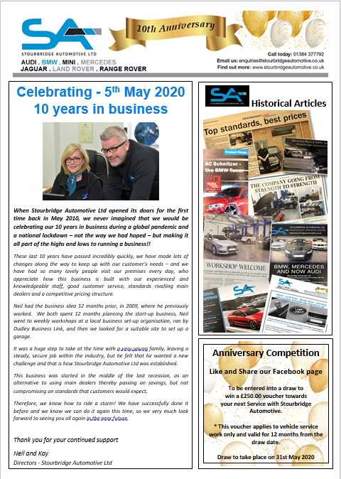
Marketing Strategy
Our company communicates using a variety of regular marketing & promotional methods including:
Company website –www.stourbridgeautomotive.co.uk
Social media – Facebook / Twitter / Linked-In / Instagram/ Tik Tok -new
Monthly blogs & email marketing
Quarterly company newsletters
Local newspaper
Lifestyle and trade magazines
SMS text messaging service
Printed literature
Events
Sponsorship of local community
organisations

Slide 11





For further information, please get in touch:
Website: www.stourbridgeautomotive.co.uk
Tel: 01384 377792
Email: enquiries@stourbridgeautomotive.co.uk
Social: @stourbridgeautomotive

